Slide 1

CRYPTO AND BLOCKCHAIN
The Currency of Future…

Slide 2
WHAT IS BLOCKCHAIN?
A blockchain is an appropriated data base that is split between PC network centers. A blockchain goes probably as an informational collection, taking care of information in an electronic plan. Blockchains are by and large known as far as it matters for them in cryptographic cash systems like Bitcoin, where they keep a protected and decentralized record of trades. The justification behind a blockchain is to ensure the commitment and security of a data record while furthermore delivering assurance without the essential for a trusted in untouchable.
The development of the data on a blockchain changes from that of a customary informational collection. A blockchain organizes data into groupings called blocks, all of which contains a combination of data. Blocks have express limit capacities and, once filled, are closed and associated with the as of late filled block, conveying a data chain known as the blockchain. All new information that follows that just contributed block is assembled in an as of late constructed block, which will moreover be added to the for the most part full chain.
An informational collection orchestrates data into tables, while a blockchain facilitates data into pieces (discourages) that are joined together, as the name proposes. Exactly when completed in a decentralized manner, this data structure makes an irreversible data arrangement. Whenever a square is filled, it turns out to be durable and approaches part of the grouping. At the point when a square is added to the chain, it is alloted an accurate timestamp.

Slide 3
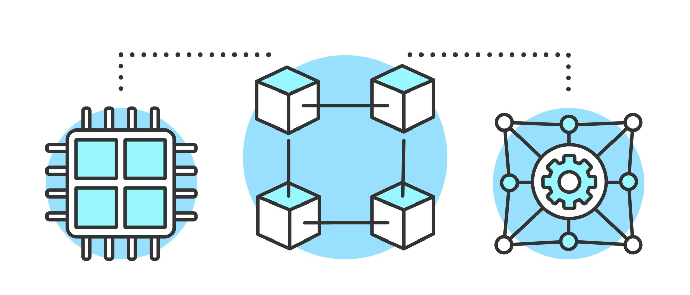

Slide 4
KEY TAKEAWAYS
Instead of standard data bases, data in blockchain is kept in blocks that are then cryptographically associated together.
As new information is gotten, it is added to another square. A data chain is formed when a square is stacked up with data and secured onto the past square.
Though a blockchain may hold a wide extent of information, it has for the most part been used as a trade record to far.
Blockchain is used in Bitcoin in a decentralized plan, and that infers that no single individual or social affair controls the structure; in light of everything, all clients have total control.
The data on a decentralized blockchain is constant, and that infers it can't be adjusted. This suggests that all Bitcoin trades are logged perpetually and may be reviewed by anybody.
CRYPTO

Slide 5
WHAT IS CRYPTOCURRENCY?
An advanced cash, generally called a computerized cash or crypto, is a sort of modernized cash that capacities as a method of exchange over a PC association anyway isn't upheld or stayed aware of by a central power like an organization or a bank.
Individual cash ownership records are taken care of in a high level record, a robotized informational index that encodes trade data, oversees coin gathering, and checks ownership moves.
Disregarding their name, cryptographic types of cash are only from time to time viewed as money related guidelines in the regular sense, and remembering that they've been designated things, securities, and financial norms, they're commonly treated as an other asset class essentially.

Slide 6
KEY TAKEAWAYS
A cryptographic cash is a high level asset that is made through the usage of a coursed association of PCs.
They can exist past the control of governing bodies and central experts on account of their decentralized development. Blockchain and similar development, most experts regarding this situation would concur, will agitate a colossal number of locales, including cash and guideline.
Advanced monetary forms have different advantages, including more affordable and faster money moves as well as decentralized structures with no failure point.
Cryptographic cash cost changes, as well as mining activities' high energy use and use in wrongdoings, are in general negatives.
CRYPTO

Slide 7
SCOPE OF PROJECT

Slide 8

Cryptographic cash is a sort of on the web or modernized cash that is taken care of and conveyed cautiously across a couple of PCs. Individuals could make and use progressed cash while safeguarding a strong environment by virtue of beginning to end encryption advancement. Bitcoin is the most outstanding advanced cash, but others consolidate wave,
Ethereum, and Dogecoin. To the extent that monetary issues, there has been a huge load of conversation about whether cryptographic cash has a limited future in India then again accepting that it has shown up at its zenith. Accordingly, we ought to analyze every single viewpoint separately. Indians are planned to place assets into FDI, normal resources, and values since they are not trying people.

Slide 9
The capacity of computerized cash is more noteworthy in developed countries than in India. This is because people in made countries, similar to the United States, are better trained and have ideal monetary conditions over people in arising countries, similar to India. In India, on the other hand, people are barely scratching by and don't have the financial means to place assets into Bitcoin. Moreover, arising country occupants are less taught than their made nation accomplices, and many ignoramus about the advantages of advanced types of cash, for instance, trade ease, unassuming trade costs, and mystery.
Whenever India demonetized in 2016, the amount of forces to be reckoned with extended. Bitcoin is simply used by colossal monetary sponsor in India, not ordinary monetary benefactors. The defense behind this is that the expense of bitcoin has been reliably extending, making it unreasonably exorbitant for a considerable number individuals, likewise the bet being referred to. It tended to for under 2% of the generally bitcoin market.
There has been a basic diminishing in many parts of the market since the Covid-19 plague. On the contrary side, various Indians have begun to learn about computerized types of cash and to place assets into them. India's computerized cash hypothesis has move from $922 million in April 2020 to $6.6 billion in May 2021 consequently. As shown by a review, India is as of now situated 11th out of 154 countries to the extent that computerized cash use.

Slide 10
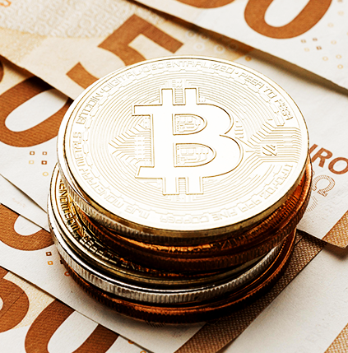
OBJECTIVES

Slide 11

OBJECTIVES
Since cryptographic forms of money are normally unstable, it's critical to comprehend how they'll impact the market. Introductory coin offers (ICOs), blockchain clashes, recent developments, and government obstruction are largely potential themes.
The means for fostering an exchanging procedure are as per the following: Cryptocurrency brokers, more than different financial backers, require an exchanging plan because of the unusualness of the bitcoin market. This is a blade that cuts both ways: merchants are attracted to the market's eccentricism, however it additionally makes exchanging troublesome. Therefore, your exchanging procedure ought to incorporate a gamble appraisal strategy, a portrayal of your targets, the cryptographic money you mean to sell, and a framework for starting and ending exchanges.
Capacity of Cryptocurrencies: Once you've settled on your choices, the main thing is to guard them. Standard protection inclusion don't cover crypto exchanging on the grounds that it isn't supported by any perceived body. They should likewise be worried about being hacked. You'll have to monitor your record and resource codes therefore. Saving your recently acquired assets in a bitcoin wallet is normally smart.

Slide 12
PROBLEM DEFINATION

Slide 13
The essential issue with blockchain is that it requires a ton of enlisting power from various sources to keep it running. This gigantic block has been beaten as a result of the creation of colossal cryptographic cash stages (for instance Bitcoin, Ethereum). To procure a prevalent data in regards to this, we ought to dive further into its arrangement of encounters.
The possibility of Blockchain had been extensively gathered in computer programming some time before it was anytime executed in computerized monetary standards. The Merkle tree was first presented in 1976 in the paper "New Directions in Cryptography," which formed into the chance of a common flowed record. It has been a critical key to data base really look at all through handling history and is one of the central foundations of the present blockchain.
A long time before it was anytime used in advanced types of cash, the possibility of Blockchain has been genuinely researched in computer programming. The Merkle tree, which formed into the chance of a common dispersed record, was first introduced in 1976 in the paper "New Directions in Cryptography." It's been a crucial key to data base affirmation all through PC history, and it's one of the present blockchain's middle underpinnings.

Slide 14
A TIMELINE ALWAYS WORKS FINE
2014
2013
2012
2011

Slide 15
LITERATURE REVIEW

Slide 16
Blockchain is a sharp development that grants cryptographically secure, decentralized, and spread data to be taken care of. The mechanical movements were made as an element of the Bitcoin computerized cash, which is prominent for working with public monetary trades among its clients.
While most recent blockchain creative work is revolved around a variety of advanced money applications, the development has been proposed and used in a collection of organizations, including open arrangements and electronic vote based. Since development can approach the present high level social orders, its application raises different moral concerns. To assess the energy level of blockchain ethics research, this study contains a coherent composing overview (n = 26) on the idiosyncrasy.
The revelations suggest that while the world is rapidly creating, legitimate, commonsense instruments — for trained professionals and scholastics the equivalent — close by a predominant data on significant moral considerations are at this point required.

Slide 17

METHODOLOGY

Slide 18
The philosophy was isolated into four stages: conspicuous confirmation, assurance, appraisal, and endorsement. Following sorting out which blockchain stages are available, a multi-measures dynamic methodology, for instance, the Simple Multi Attribute Rating Technique is utilized to pick a palatable blockchain stage (SMART). The picked system is next totally explored, with novel thought paid to the blockchain stage's structure designing, libraries, instruments, region express applications, and capacities assessment. Through the development of a blockchain-based business course of action, the proposed procedure has been supported. The communication show presented in this study can be used by any accomplice, paying little notice to scale, to perceive a fitting blockchain stage for building a blockchain application.

Slide 19
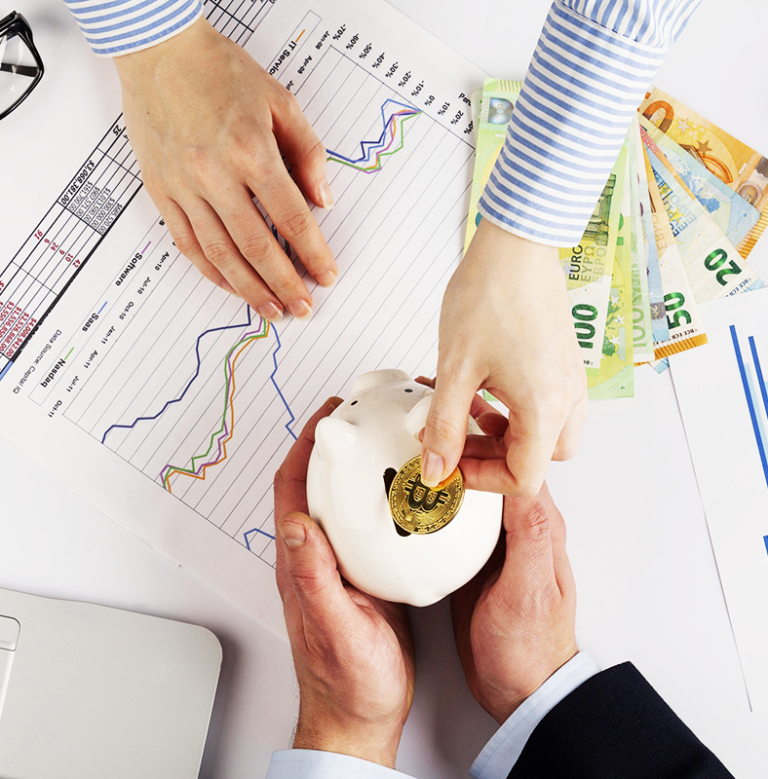
CONCLUSION

Slide 20
The cryptographic cash based blockchain development might potentially annoyed a wide extent of undertakings. It ensures that the authentic background of automated assets is unalterable and direct by joining decentralization and cryptographic hashing. Cryptographic cash and blockchain advancement are indistinguishably associated. The best thing about cryptographic types of cash is that no single substance or individual controls them.
The ascent of Bitcoin has started a discussion over the fate of Bitcoin and other cryptographic forms of money. In spite of ongoing misfortunes, Bitcoin's prosperity since its send off in 2009 has powered the improvement of contender cryptographic forms of money like Ethereum, Litecoin, and Ripple. A digital currency that needs to be acknowledged into the standard monetary framework should meet various measures. While that chance is remote, it is evident that Bitcoin's prosperity or disappointment in managing the issues it faces in the years ahead will immensely affect the fortunes of other digital currencies.

Slide 21

PRESENTATION BY- TUSHAR BAJAJ ASHISH JOHN ABHAY GARG
CRYPTO
CRYPTO

